Slide 1
CS8661 – Mini Project Work
Pathfinding Algorithm Visualizer
Presented By
M.Arjun (910718104004)
N.Mohamed Aashik (910718104019)
N.Sathish kumar (910718104025)

Slide 2
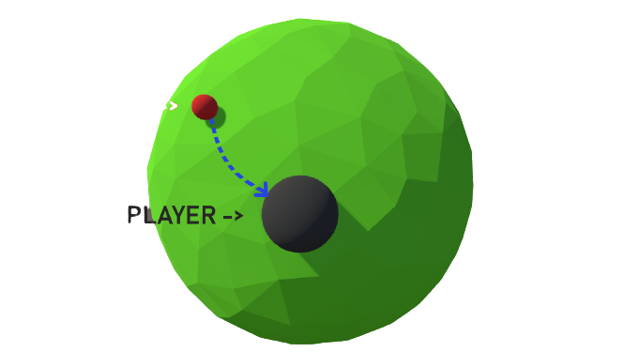
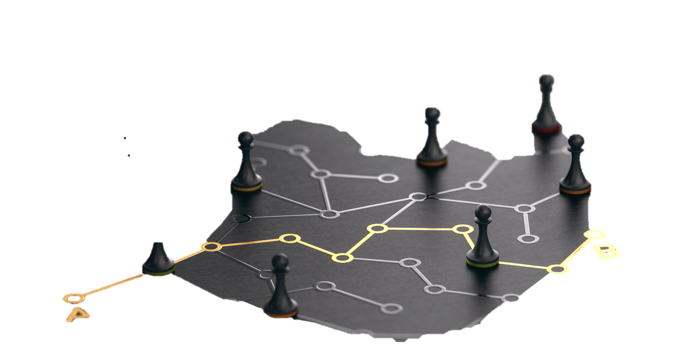
Pathfinding Algorithm :
Pathfinding algorithms are usually an attempt to solve the shortest path problem in graph theory. They try to find the best path given a starting point and ending point based on some predefined criteria.
What is the shortest path problem?
“In graph theory, the shortest path problem is the problem of finding a path between two vertices (or nodes) in a graph such that the sum of the weights of its constituent edges is minimized.”

Slide 3




Area of interest :
HTML
CSS
Javascipt
Node js
Abstract :
Visualizations of algorithms contribute to improving computer science education. The process of teaching and learning of algorithms is often complex and hard to understand the problem. Visualization is a useful technique for learning in any computer science course. In this paper, an e-learning tool for shortest paths algorithms visualization is described. To make this visualizer you need to be at least an intermediate level in front end programming (HTML, Nodes, CSS) and a good understanding of some pathfinding algorithm.

Slide 4
Algorithms:
Dijkstra’s Algorithm
Breadth-First Search
Depth-First Search
A Star Algorithm
Greedy Best-First Search

Slide 5
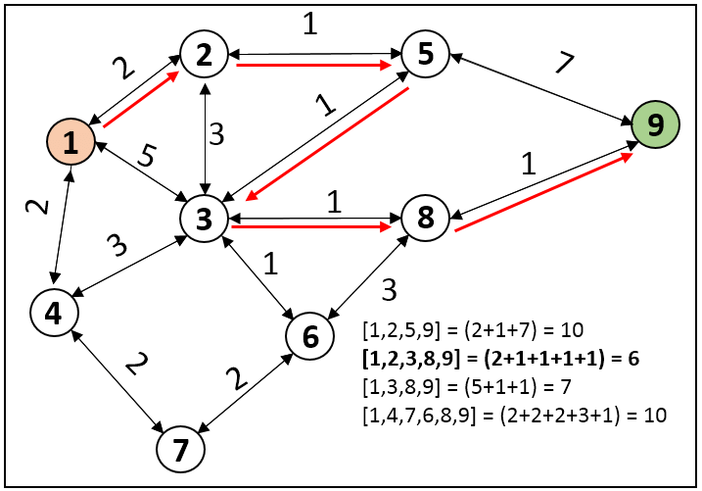
Dijkstra’s Algorithm
It is an algorithm for finding the shortest paths between nodes in a weighted graph.
We'll use the new addEdge and addDirectedEdge methods to add weights to the edges when creating a graph. Let us look at how this algorithm works.

Slide 6
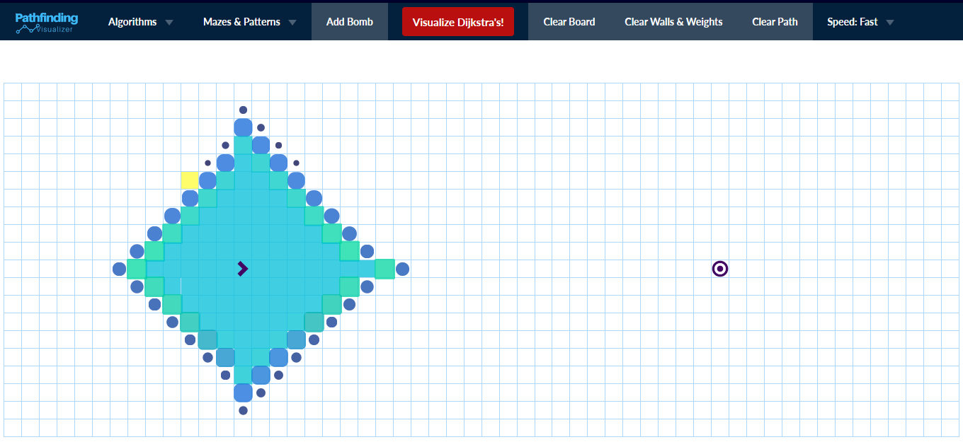

Slide 7
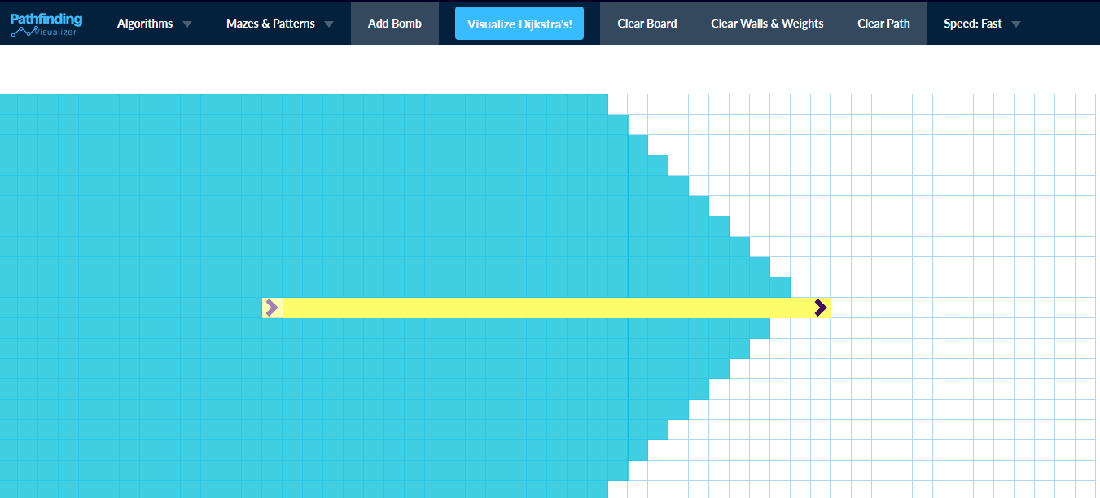

Slide 8
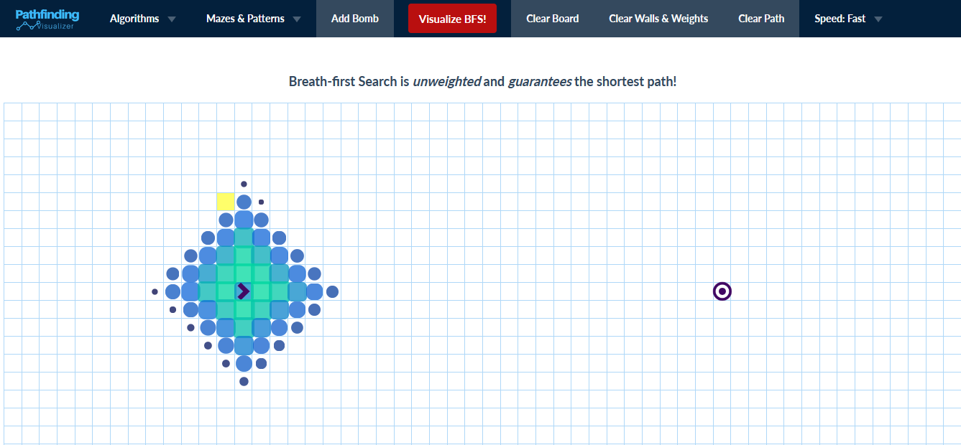

Slide 9
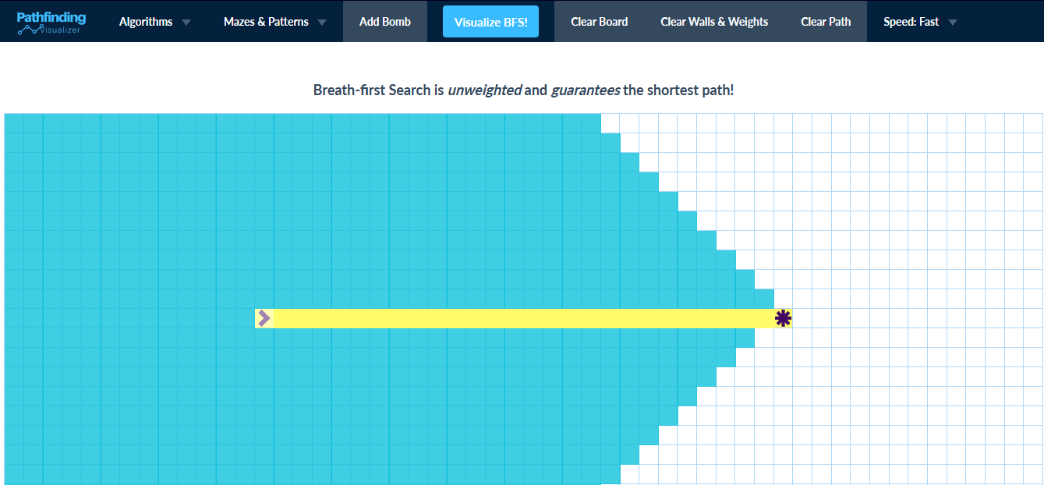

Slide 10
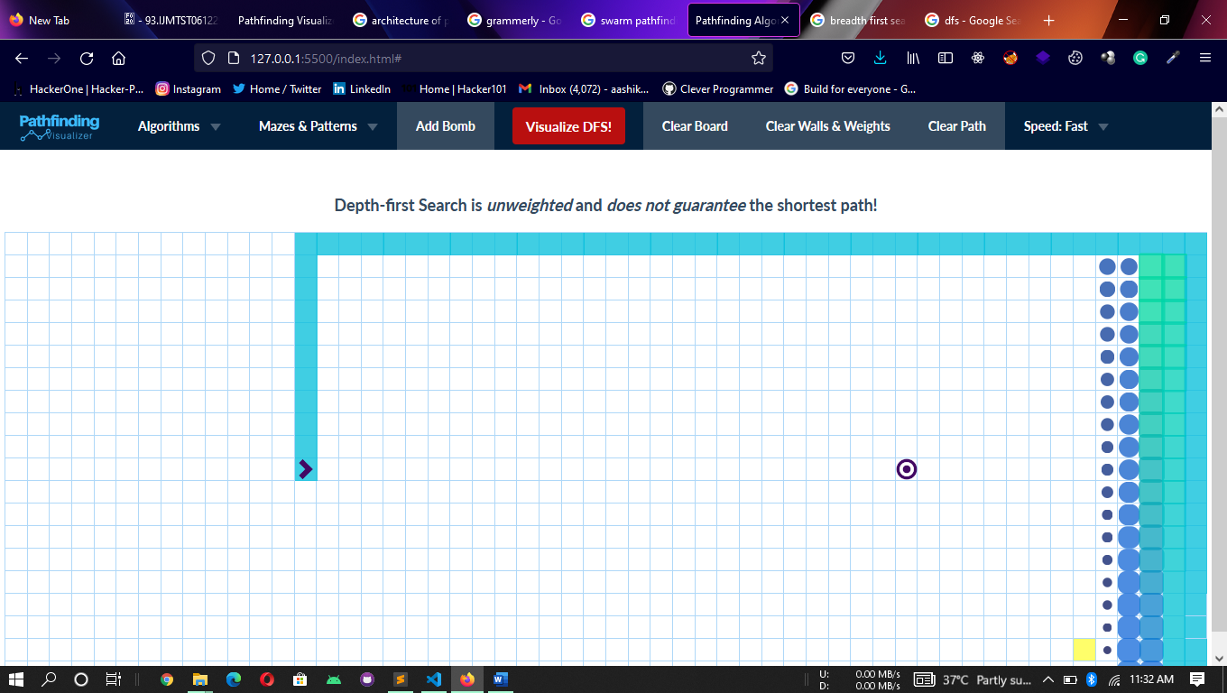

Slide 11
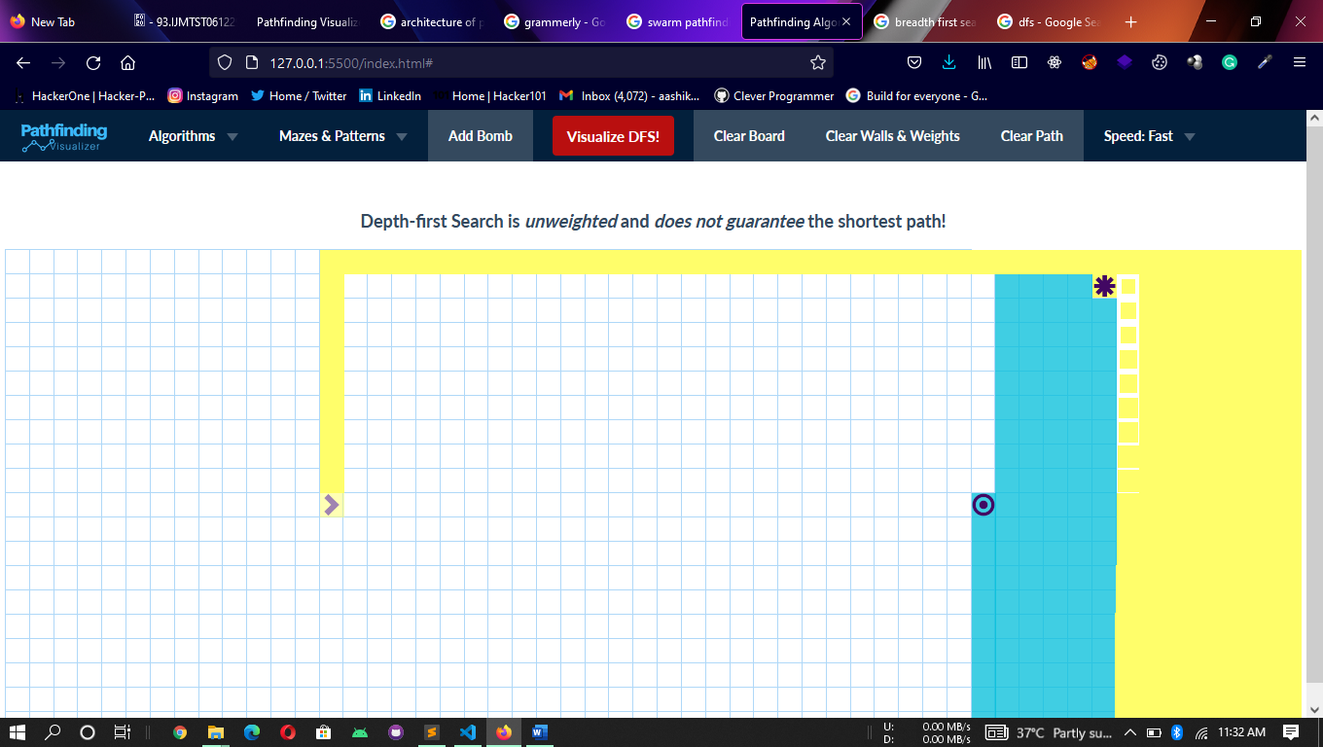

Slide 12
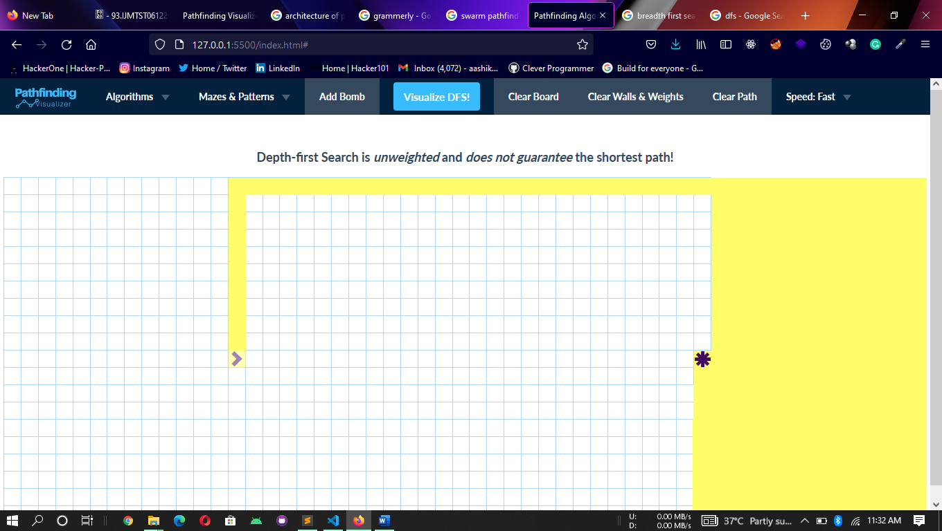

Slide 13
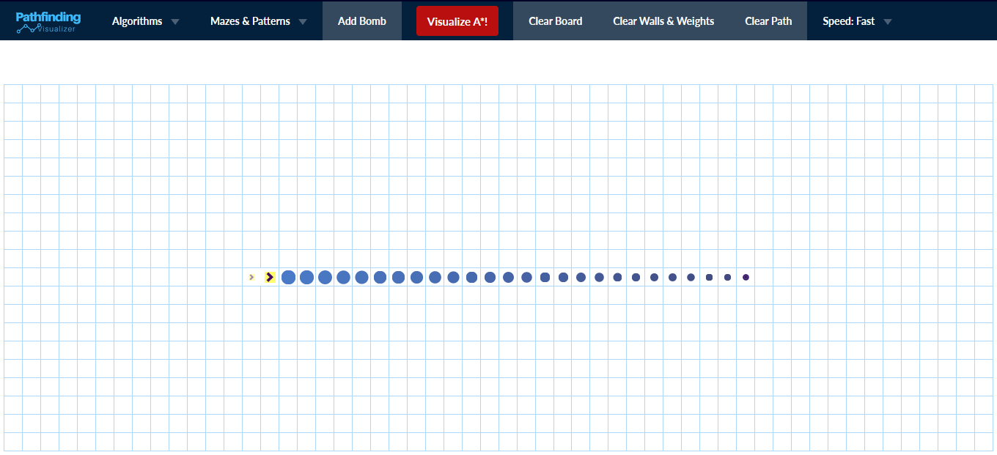

Slide 14
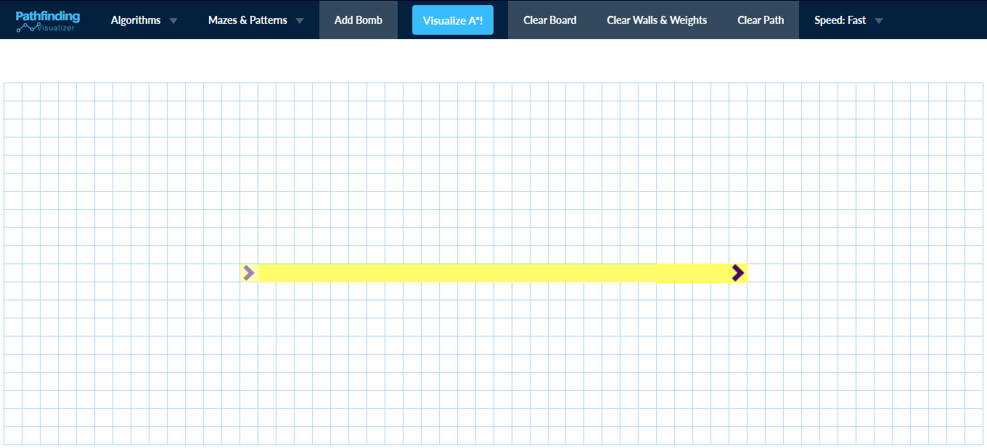

Slide 15
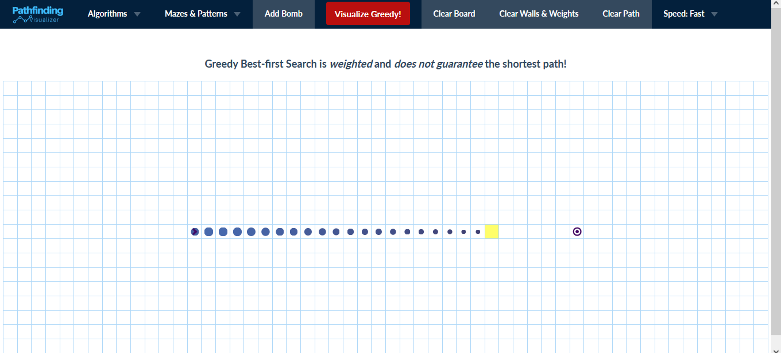

Slide 16
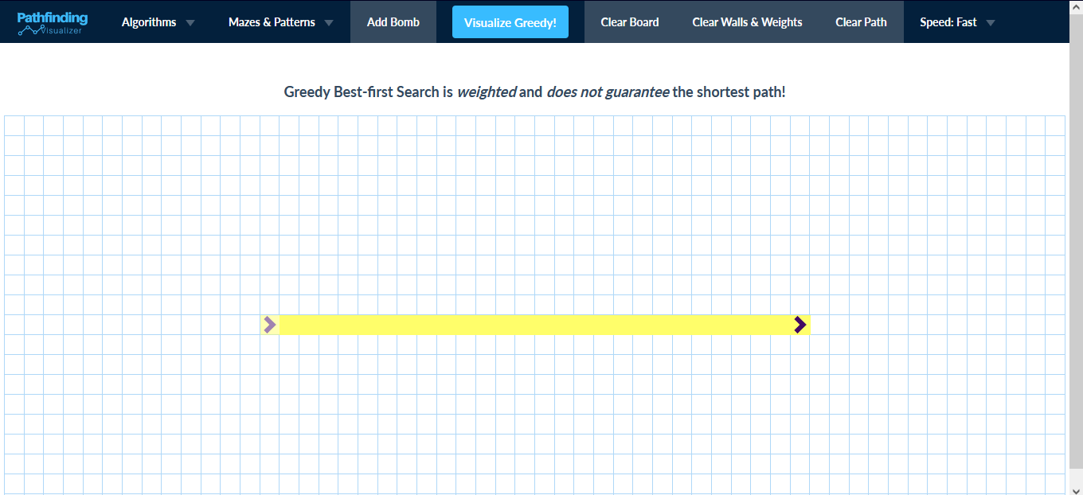

Slide 17
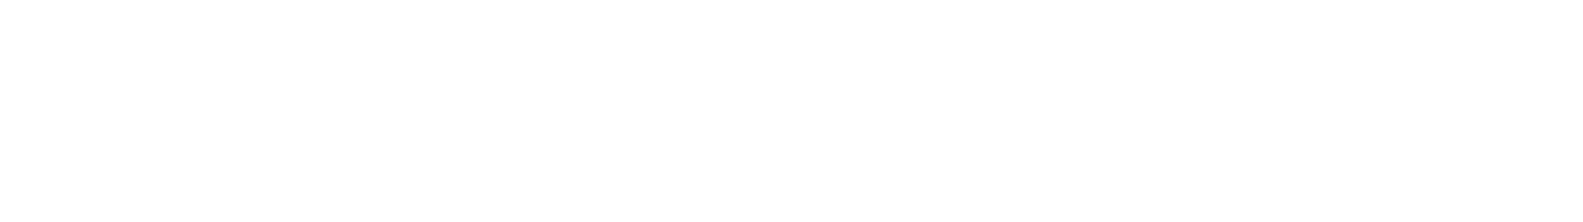

Architecture of the project

Slide 18


Slide 19
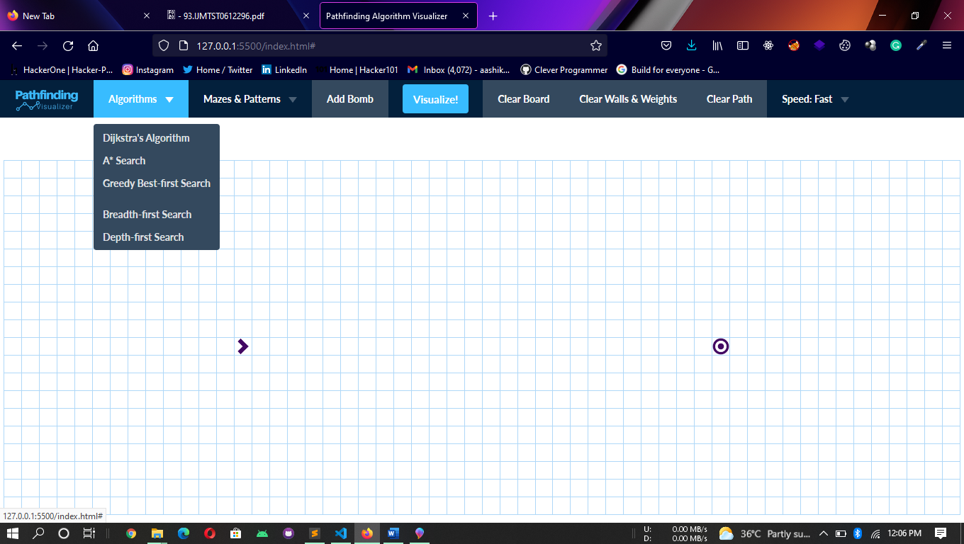

Slide 20
Conclusion:
With the completion of this project, we have successfully achieved our objective of our project is to embed Graph Path Finding with Visualization and Comparing their performance.
The main idea of the system is to provide an integrated educational environment for both instructors and students to facilitate the learning process in efficient way.
LIVE DEMO: https://pathfindingalgorithmvisualizer.mohamedaashik.repl.co/

